Slide 1
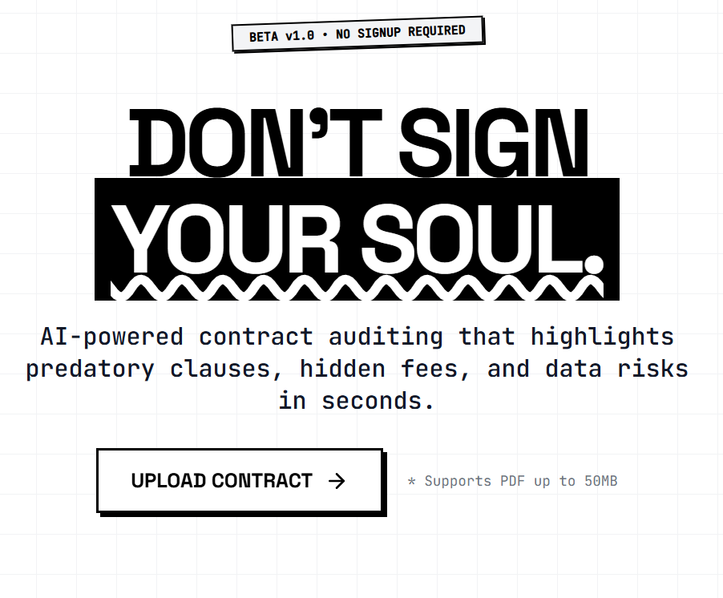
SUBTEXT
Don't Sign Your Soul.

Slide 2

THE PROBLEM
The "I Agree" Lie.
We all do it. Click "I Agree" without a second thought. These complex digital contracts, often 50+ pages of dense legalese, are intentionally designed to be ignored. This pervasive complacency exposes us to significant, often invisible, risks.
91% Consent Blindly
Vast majority agree to terms without reading them.
Hidden Dangers Lurk
From data selling to forced arbitration, predatory clauses are rife.

Slide 3
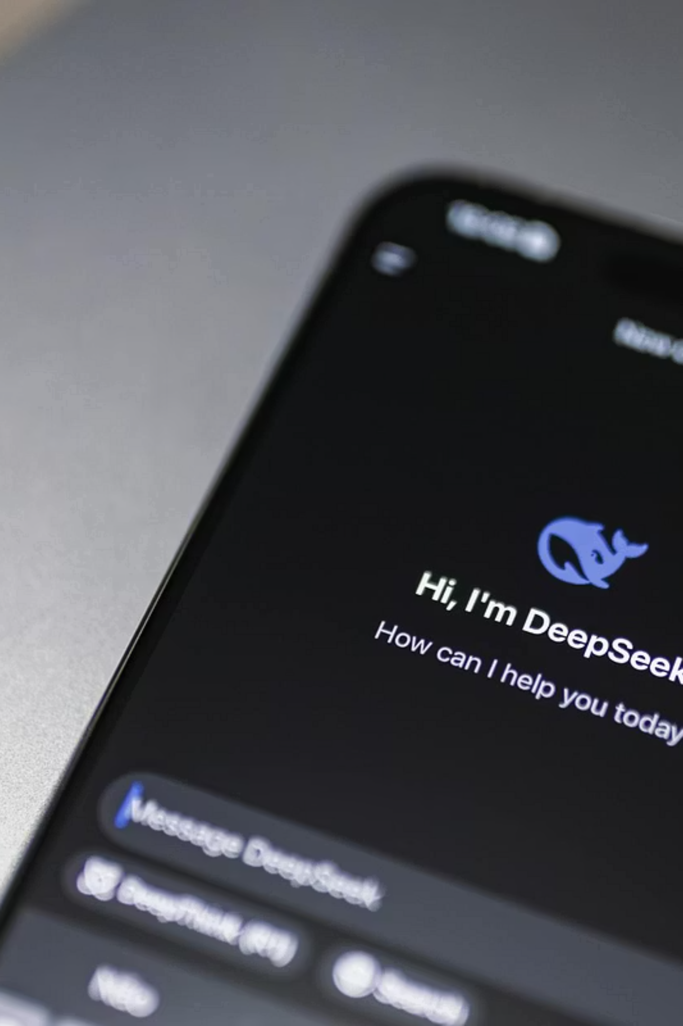



THE SOLUTION
AI-Powered Auditing.
Subtext isn't just a summariser; it's an intelligent agent engineered to read the fine print for you. It's a proactive risk detector, parsing, understanding, and red-flagging predatory clauses in mere seconds, providing clarity where there was once confusion.
Intelligent Agent
Beyond summarising, it comprehends intent.
Risk Detector
Specifically identifies and flags problematic clauses.
Instant Analysis
Processes documents and highlights risks in seconds.

Slide 4
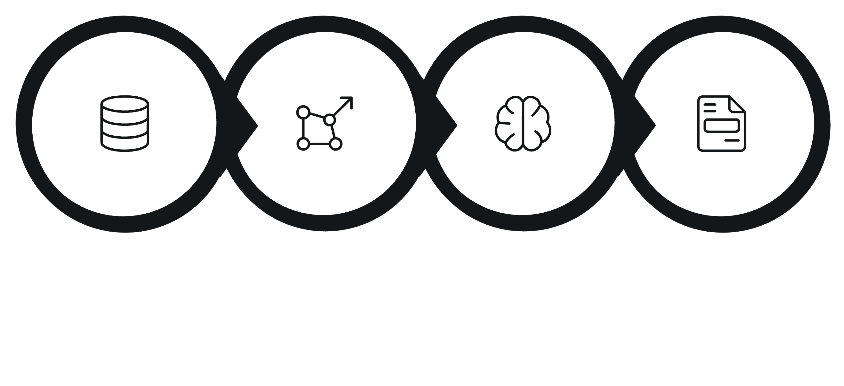




How It Works
Vectorization
Report Generation
Ingestion
Logic Loop
Subtext operates through a streamlined, high-performance architecture, transforming complex legal documents into actionable insights.

Slide 5
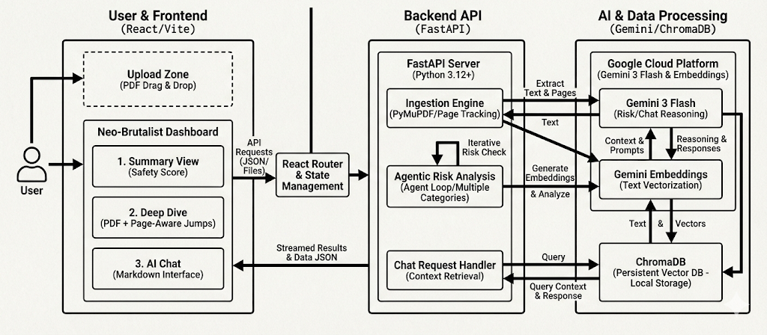
THE ARCHITECTURE
The final output is a concise, qualitative Executive Summary, complemented by an interactive UI that allows users to "deep dive" into specific areas of concern.

Slide 6
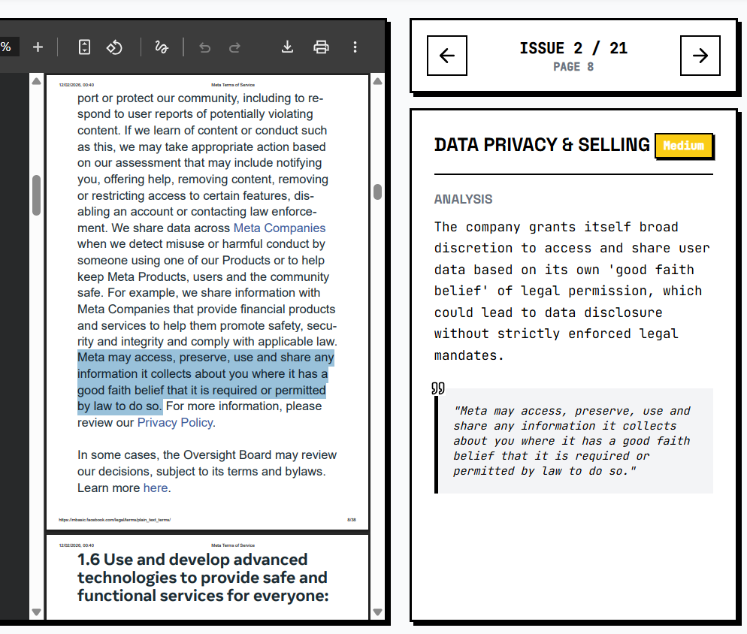
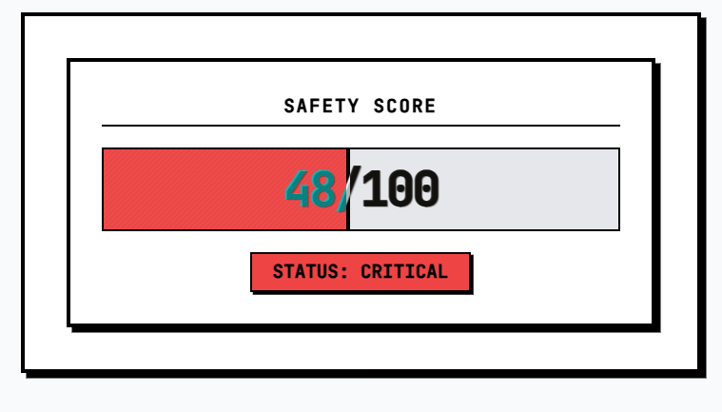
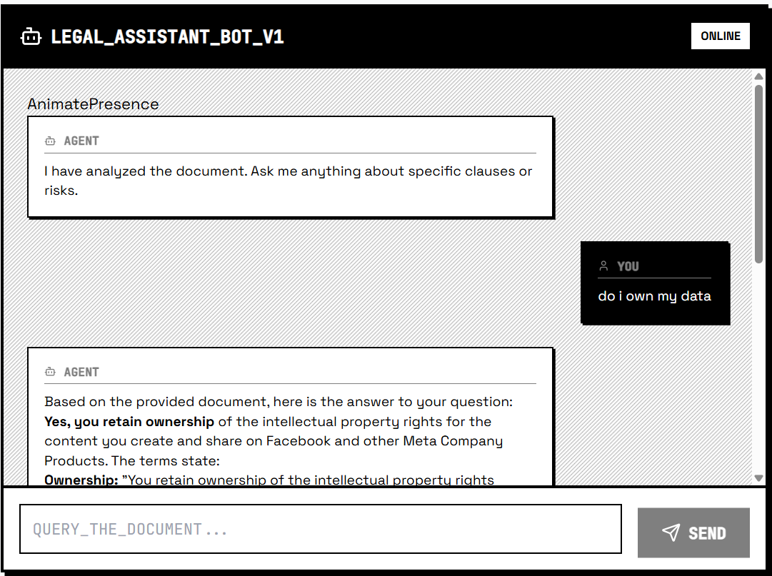
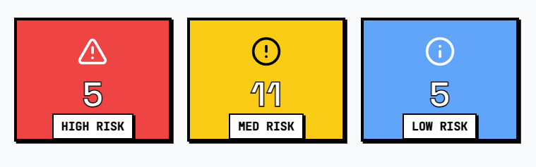
KEY FEATURES
Unpacking Subtext's Power.
Deep Dive Navigation
AI Chat Interface
Real-Time Scoring
Seamlessly click on a flagged risk to jump directly to the precise clause within the original PDF, ensuring contextual understanding.
Engage with our AI: ask questions such as "Can they sell my photos?" and receive immediate, cited answers, offering precise clarification.
An intuitive "Safety Score" provides an immediate, at-a-glance gut check on the overall risk level of any document.

Slide 7

TECH STACK
Engineered for Performance.
Frontend
React + Vite + TailwindCSS for a responsive, modern user experience.
Backend
Python FastAPI ensures robust, high-speed API services.
AI Core
Google Gemini 3 Flash + Vertex AI for cutting-edge intelligence.
Database
ChromaDB powers lightning-fast vector search and retrieval.

Slide 8
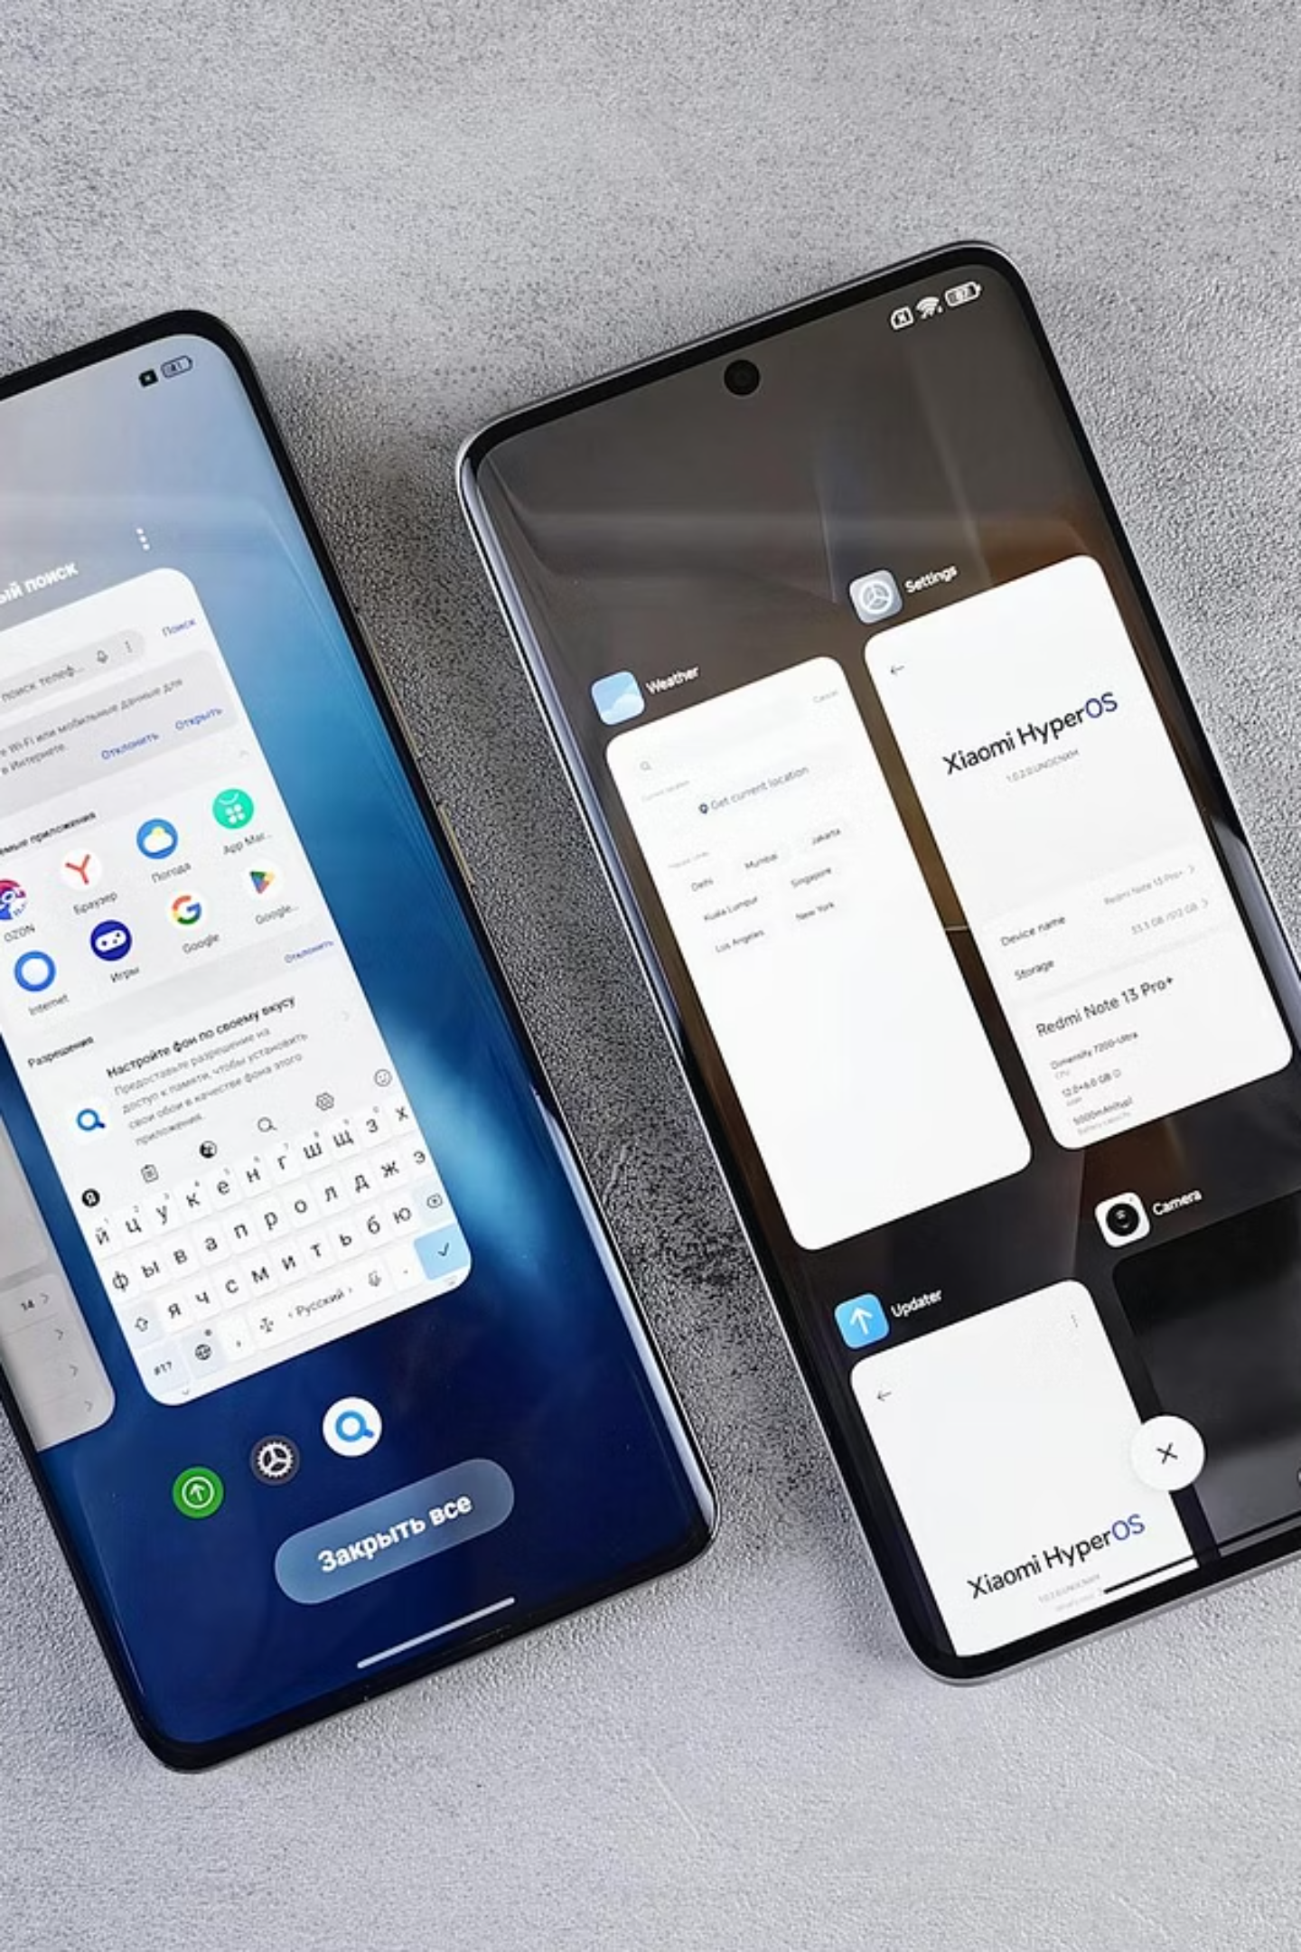
FUTURE
The Road Ahead.
Our vision extends beyond the current offering. We are continuously evolving Subtext to integrate seamlessly into your digital life, ensuring you're always protected.
01
02
Browser Extension
Compare Feature
Instantly audit agreements directly from your web browser.
Analyse changes between different versions of legal documents.
03
Mobile App
On-the-go auditing for all your mobile devices.

Slide 9


Reclaim Your Consent.
Don't be a casualty of fine print. Empower yourself with clarity and control. Try Subtext today and transform how you interact with legal documents.

